Slide 1

uCapture Mission Statement
Using crowdsourced data incentivized via gamification, we increase the efficiency of the institution while increasing quality of service to students.
Team Capture Presents

Slide 2
Problem Statement
Imagine you are washing your hands in the restroom. You then proceed to reach for paper towels, but you see there are none.
Most people would not get out their phone and call facilities, thus the problem and its data gets ignored.
uCapture will serve as a platform where stakeholders can report anything they perceive to be a problem. Through crowdsourced human intelligence, our priority of the problem will be determined.

Slide 3
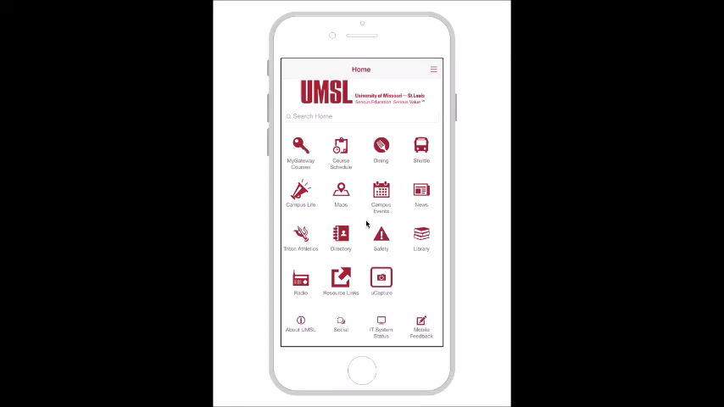
Solution

Slide 4
Technical Specifications
Java
Netbeans IDE
Derby Database
Why is uCapture different from other existing apps?
Geofencing
Real time ,accurate and simple UI
Feedback based prioritization
Gamification

Slide 5
Business Model
Key Partner: Any organization that wants to connect in an efficient way
Cost Structure: Winning the UMSL|Hack 2017 to raise capital
Multiple Revenue Streams:
Recurring subscriptions revenue
Third party licensing
Per active user pricing

Slide 6
Benefits
User/Customer Benefits
Ease of access
Increase quality of service and safety
The community feels more involved
Users are rewarded for their participation (Gift card, coffee)
Organization Benefits
Increase efficiency of workforce
Increase quality of service
Mitigates liability
Visibility of frequent patterns leading to cost efficient solutions
Increase brand value
C2B support in app

Slide 7
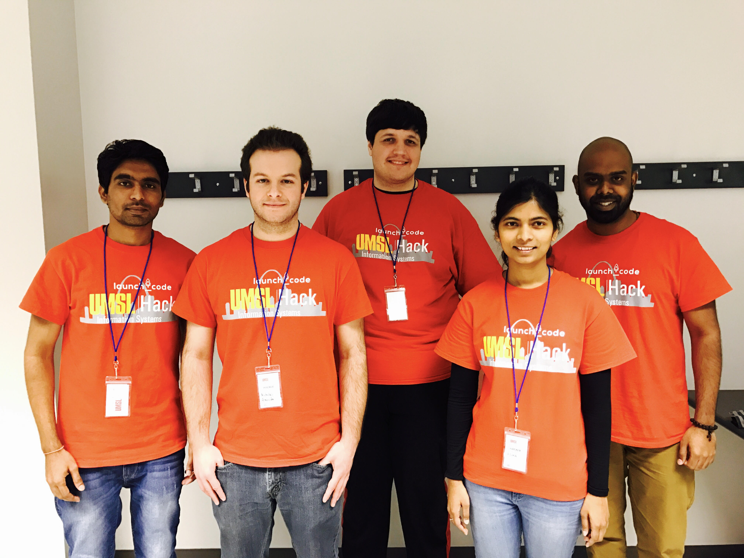
Team Capture Thanks UMSL|Hack

